Slide 1

Parents and Carers · Primary · Session 6
Full Circle
Notes:
SUGGESTED TIME: 2 min · 2:10 - 2:12
PURPOSE
Open the final session and return to the child participants described at the start of the day.
WHAT TO DO
1. Name this as a short, practical closing session.
2. Invite one or two people to look back at the one thing they wanted to know from Session 1 and say what has shifted, or what has been answered. Keep this to 1 to 2 minutes.
3. Invite participants to look again at the three things they wrote about their child in Session 1.
4. Explain that they will choose a few small actions to carry forward, not a long list.
5. Keep the closing grounded rather than adding new content.
KEY MESSAGES
• The day comes back to your child as a whole person.
• One or two small steps are more useful than a long list.
THREAD
Returns to 'What are some things you love or value about your child?' and the one thing participants wanted to know from Session 1.

Slide 2
Belonging, capacity and joy
Keep all three in the picture.
Belonging
Being recognised, included and able to participate as oneself
Capacity
What the day costs, protects and restores
Joy
Interests, connection and authentic expression
Return to these when judging whether a change supports flourishing.
Notes:
SUGGESTED TIME: 2 min · 2:12 - 2:14
PURPOSE
Bring the day together through belonging, capacity and joy.
WHAT TO DO
1. Present belonging, capacity and joy together, as connected ideas.
2. Belonging: being recognised, included and able to participate as oneself.
3. Capacity: what the day costs, protects and restores.
4. Joy: interests, connection and authentic expression.
5. Point to the last line on the slide: return to these three when judging whether a change supports flourishing.
YOU MIGHT SAY
Keep all three in the picture.
KEY MESSAGES
• Belonging, capacity and joy matter as much as getting through the day.
• A change at home or at school can be checked against all three.
KEEP IN MIND
• Avoid presenting school results, quiet compliance or doing things alone as the only signs that a child is doing well.
THREAD
Capacity picks up the batteries, spoons and fluctuating capacity from Session 3 (what costs your child energy and what helps restore it) and your own battery from Session 4; joy picks up interests as an anchor from Session 4.

Slide 3
Bringing it all together
Three small things. Write them in your workbook.
1
One thing to try at home this week. Keep it small.
2
One thing you would like school to know, understand or support, and the sentence you will open with.
3
One strength you see in your child, and a plan to tell them this week.
Notes:
SUGGESTED TIME: 8 min · 2:14 - 2:22 · Workbook - Three small things
PURPOSE
Help each participant choose three small, specific actions across home, school and their child's positive identity.
WHAT TO DO
1. Introduce the three small things on the slide.
2. Allow quiet writing time in the Workbook.
3. Encourage participants to keep each action small enough to start this week.
4. For the school item, point participants back to their notes from Session 5, slide 14.
5. Invite one or two people to share if they wish; sharing is optional.
KEY MESSAGES
• A useful action can be small and specific.
• The three prompts connect home, school and your child's positive identity.
ACTIVITY: Individual reflection and action planning · on your own · 8 minutes
Prompt: Three small things. Write them in your workbook.
1. One thing to try at home this week. Keep it small.
2. One thing you would like school to know, understand or support, and the sentence you will open with.
3. One strength you see in your child, and a plan to tell them this week.
Close: Invite participants to keep their notes somewhere they will see them after the workshop.
KEEP IN MIND
• Some families are going through a very hard time. If someone cannot think of an action today, that is fine. Naming a strength may be enough.
THREAD
Draws together the Session 4 idea to try at home, the Session 5 conversation plan and the Session 1 strengths.

Slide 4
Connections that continue
Each other
The families in this room understand things others may not. Connections made today can last.
Parent groups
Local and online groups, for the questions that come up later.
Webinars and deep dives
Titles and dates to confirm
Online Community of Practice
Link and QR code TBA
Asking for help is part of parenting. You did that by coming today.
Notes:
SUGGESTED TIME: 2 min · 2:22 - 2:24
PURPOSE
Point participants towards continued connection with other families, parent groups, family webinars and the online Community of Practice.
WHAT TO DO
1. Name the four options on the slide: each other, parent groups, webinars and deep dives, and the online Community of Practice.
2. Invite participants to swap contact details with others at their table if they would like to.
3. Explain how to access the webinars and the Community of Practice.
4. Avoid implying that every option will suit every family.
5. Read the last line on the slide: asking for help is part of parenting.
YOU MIGHT SAY
Asking for help is part of parenting. You did that by coming today.
KEY MESSAGES
• Connection after today can come through other families, parent groups or online.
• Choose the kind of connection that fits you.

Slide 5



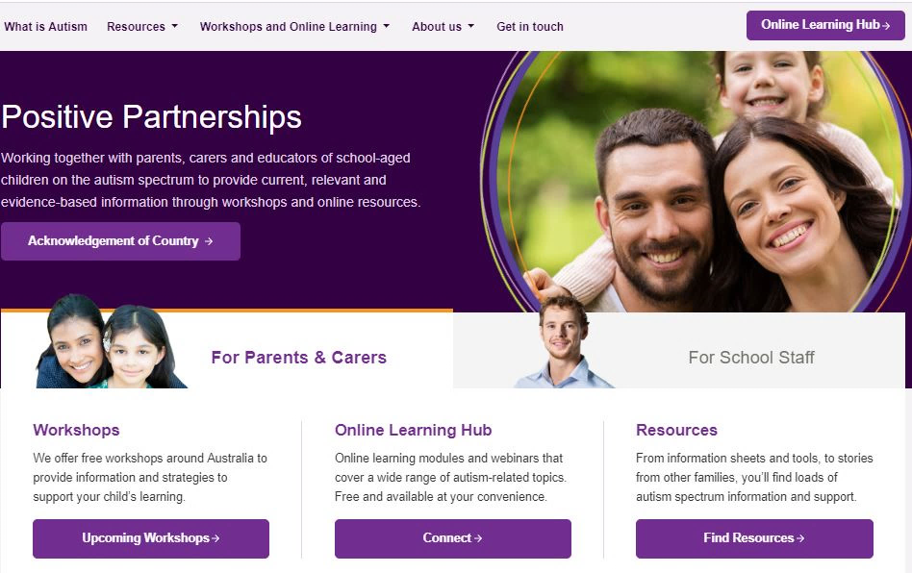


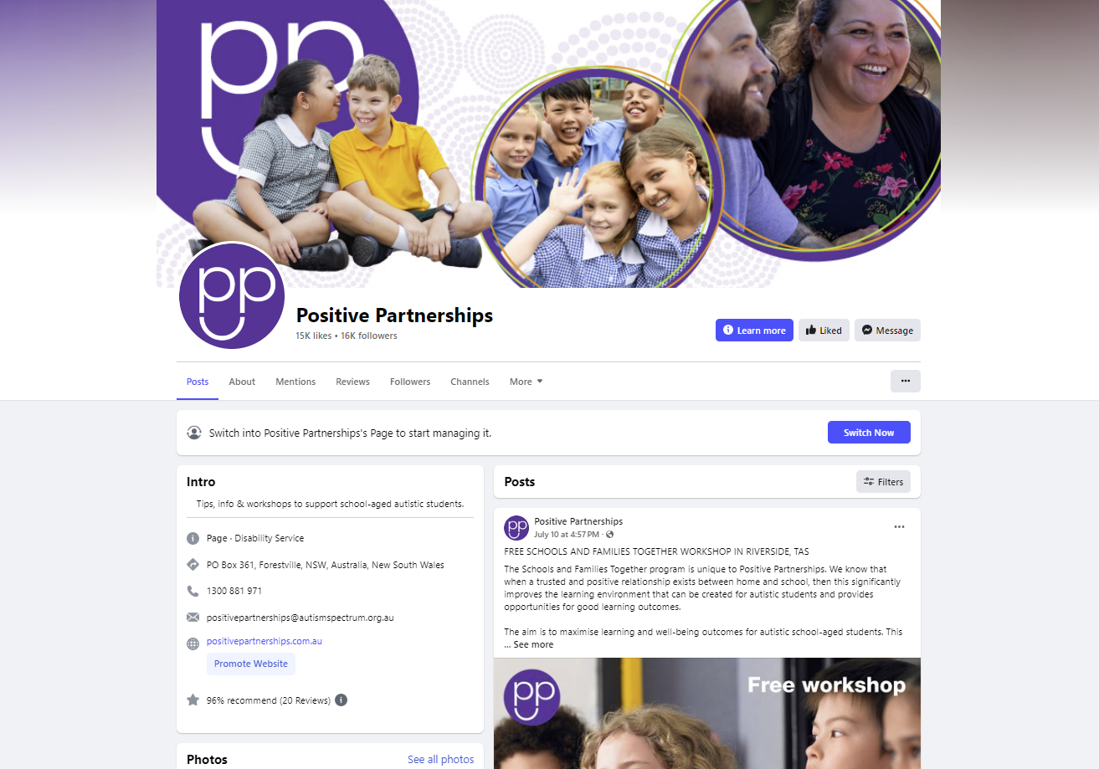

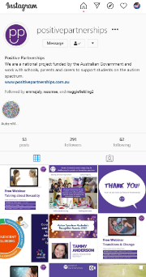


Resources
LinkedIn Positive Partnerships
Instagram @positivepartnerships
Threads @positivepartnerships
pinterest.com.au/
PositivePartnershipsAustralia/
facebook.com/PositivePartnershipsAU
positivepartnerships.com.au
Notes:
SUGGESTED TIME: 1 min · 2:24 - 2:25
PURPOSE
Show where to follow Positive Partnerships online.
WHAT TO DO
1. Leave the slide up briefly so participants can note or photograph the handles.
2. Mention that the website has resources for families on many of today's topics.
RESOURCES
Positive Partnerships website - positivepartnerships.com.au
Facebook - facebook.com/PositivePartnershipsAU
Instagram - @positivepartnerships
Threads - @positivepartnerships
LinkedIn - Positive Partnerships
Pinterest - pinterest.com.au/PositivePartnershipsAustralia/

Slide 6


Feedback
Feedback link and QR code: TBA
Notes:
SUGGESTED TIME: 4 min · 2:25 - 2:29
PURPOSE
Collect participant feedback on the workshop.
WHAT TO DO
1. Explain why feedback is collected and how it helps shape future workshops for families.
2. Show how to access the form, using the feedback link (TBA) and QR code.
3. Allow protected time for completion in the room.
4. Offer an alternative for anyone who cannot use the online form.
KEEP IN MIND
• The slide shows a placeholder: add the feedback link (TBA) and QR code before delivery.
RESOURCES
Feedback link and QR code: TBA

Slide 7

Good luck on your journey
Stay curious.
Keep your child at the centre.
Take one small next step, include the people who know your child well and see what happens. Small changes can be adjusted as you go.
Notes:
SUGGESTED TIME: 1 min · 2:29 - 2:30
PURPOSE
Close warmly and return participants to their child and one small next step.
WHAT TO DO
1. Thank participants for their time, their questions and what they shared about their children.
2. Invite them to stay curious and keep their child at the centre.
3. Remind participants to take their Workbook with their three small things.
4. State the follow-up and contact arrangements.
KEY MESSAGES
• Stay curious.
• Keep your child at the centre.
• Take one small next step and include the people who know your child well. Small changes can be adjusted as you go.

